Slide 1


Al-Karkh University for Science
Collage of Science
Medical Physics Department
General Biology II
" Practical"
Prepared by
Dr. Hiba Shakir Ahmed Dr. Rawa Abdul Redha Aziz
Ph.D Microbiology/Immunity Ph.D Antibiotic Molecular Biology

Slide 2
Polymerase Chain Reaction (PCR) & Gel Electrophoresis
Lab ((5))

Slide 3
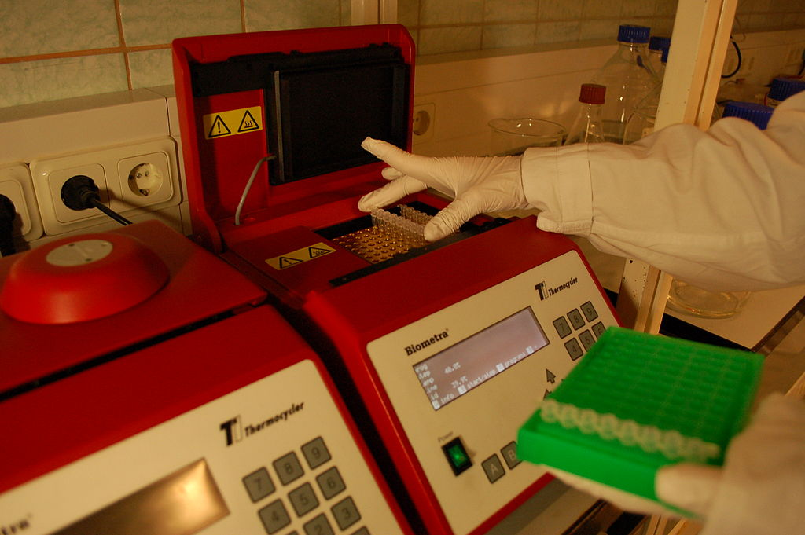
Polymerase Chain Reaction (PCR) & Gel Electrophoresis
PCR is a scientific technique in molecular biology to amplify a single or few copies of apiece of DNA across several orders of magnitude, generating thousands to millions of copies of a particular DNA sequence.
POLYMERASE CHAIN REACTION (PCR)

Slide 4
The principle
The method relies on thermal cycling, consisting of cycles of repeated heating and cooling of the reaction for DNA melting and enzymatic replication of the DNA.
Primers (short DNA fragments, 10-20bp) containing sequences complementary to the target region along with a DNA polymerase (after which the method is named) are key components to enable selective and repeated amplification.
As PCR progresses, the DNA generated is itself used as a template for replication, setting in motion a chain reaction in which the DNA template is exponentially amplified.
PCR can be extensively modified to perform a wide array of genetic manipulations.

Slide 5
Procedure
Initialization: This step is only required for DNA polymerases that require heat activation by hot-start PCR. It consists of heating the reaction chamber to a temperature of 94–96 °C, or 98 °C if extremely thermostable polymerases are used, which is then held for 1–10 minutes.
Denaturation: This step is the first regular cycling event and consists of heating the reaction chamber to 94–98 °C for 20–30 seconds. This causes DNA melting, or denaturation, of the double-stranded DNA template by breaking the hydrogen bonds between complementary bases, yielding two single-stranded DNA molecules.
Annealing: In the next step, the reaction temperature is lowered to 50–65 °C for 20–40 seconds, allowing annealing of the primers to each of the single-stranded DNA templates. Two different primers are typically included in the reaction mixture: one for each of the two single-stranded complements containing the target region. During this step, the polymerase binds to the primer-template hybrid and begins DNA formation.

Slide 6
Extension/elongation: The temperature at this step depends on the DNA polymerase used; the optimum activity temperature for the thermostable DNA polymerase of Taq (Bacteria: Thermus aquaticus) polymerase is approximately 75–80 °C, though a temperature of 72 °C is commonly used with this enzyme. In this step, the DNA polymerase synthesizes a new DNA strand complementary to the DNA template strand by adding free dNTPs from the reaction mixture that are complementary to the template in the 5'-to-3' direction, condensing the 5'-phosphate group of the dNTPs with the 3'-hydroxy group at the end of the nascent (elongating) DNA strand. The precise time required for elongation depends both on the DNA polymerase used and on the length of the DNA target region to amplify.
Final elongation: This single step is optional, but is performed at a temperature of 70–74 °C for 5–15 minutes after the last PCR cycle to ensure that any remaining single-stranded DNA is fully elongated.
Final hold: The final step cools the reaction chamber to 4–15 °C for an indefinite time, and may be employed for short-term storage of the PCR products.

Slide 7
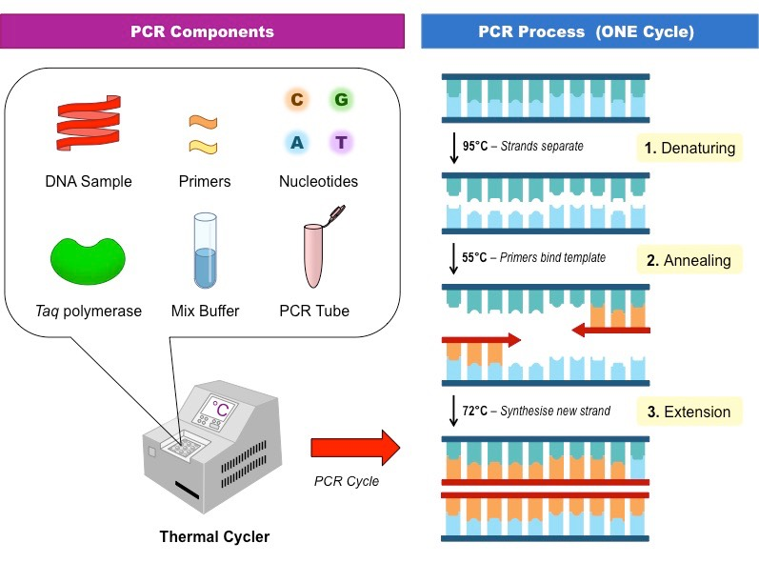
PCR component & process

Slide 8
Gel Electrophoresis
  DNA electrophoresis is an analytical technique used to separate DNA fragments by size and is usually used after PCR.
  Because you developed primers to amplify a specific segment of DNA, after PCR you should know the size of the amplified DNA fragment.
  DNA molecules which are to be analyzed by DNA electrophoresis are set upon a viscous medium, the gel, where an electric field forces the DNA to migrate toward the positive potential, the anode, due to the net negative charge of the phosphate backbone of the DNA chain.

Slide 9
  The separation of the DNA fragments from your PCR reaction is accomplished by exploiting the mobilities with which different sized molecules are able to traverse the gel. Longer molecules migrate more slowly because they experience more drag within the gel.
  After some time, the voltage is removed and the fragmentation gradient is analyzed by comparing the PCR products to ladder (DNA products of known size) that is run simulaneously.

Slide 10
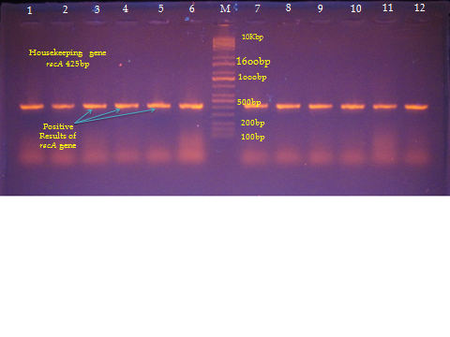
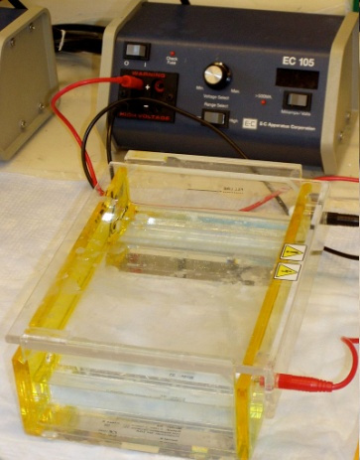
RecA gene of Acinetobacter baumannii gel electrophoresis

